Slide 1
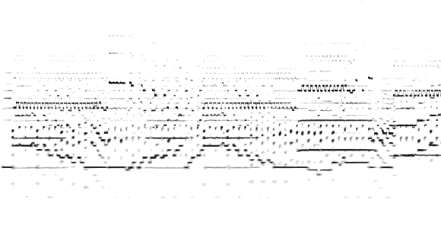
Multiple F0 Estimation

Slide 2
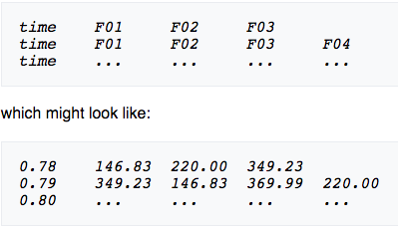
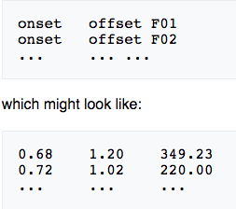
What are we trying to do: MF0E
…biting off more than we can chew?
The goal is to identify the active F0’s in each time frame and track those notes and timbres continuously.
Given that this is a complex task the MIREX community is only focusing on 3 areas:
1) Estimate active fundamental frequencies on a frame-by-frame (10ms) basis
2) Track note contours over time (piano transcriptions sub task)
3) Track timbre over time (this was cancelled due to lack of participation)
So the output of the algorithm is in two parts:
1) F0 estimations of each frequency
2) Onset / Offset of those frequencies followed by the respective frequency
….btw it outputs a note transcription

Slide 3
MIREX Dataset 2007:
- This is comprised of a woodwind quintet - 5 var. L van Beethoven's Variations for String Quartet
Op.18 No. 5. Each part was iso recorded and mixed into 1 mono file
- Synthesized pieces from classical and Jazz collections with 1 to 4
sources using RWC MIDI and Samples
- Polyphonic piano recordings using a disklavier playback piano
These files are
- 6, 30 second clips, each having a polyphony of 2-5 instruments
for a total of 30 examples
- 10, 30 second polyphonic piano clips

Slide 4
MIREX Evaluation 2007
Task 1 (frame level evaluation)
- Pitch is assumed correct if it is within a half semitone (+/- 3%) of a ground truth for that 10ms frame.
Task 2 (note on/offset tracking)
- Note is assumed correct if it is within a half semitone (+/- 3%) of a ground truth for that 50ms range (+/- 25ms) or 5 frames with a 2 ½ frame error margin.
Categories of Results:
Precision (the amount correct pitches from all pitches retrieved for each frame)
and
Recall (ratio of correct pitches to all ground truth pitches for each frame)

Slide 5

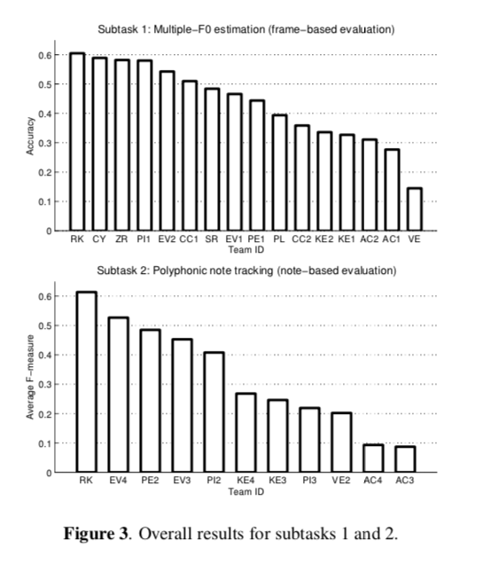
Results 2007:
1st Place - Matti Ryyna ̈nen and Anssi Klapuri had the winning
algorithm in both categories (precision and recall) algorithm
took 59 minutes. They acknowledge that most of the processing time was on F0 estimation and a more efficient algorithm would speed up the on/offset computations
2nd Place - Chunghsin Yeh algorithm took 36.75 hours
3rd Place - JRuohua Zhou, Joshua D. Reiss algorithm took 4.5 minutes

Slide 6
Su Dataset 2015:
This data developed to contain a wider range of real-world music in comparison to the old dataset used in 2007.
- 3 clips of solo piano
- 3 clips of string quartet
- 2 clips of piano quintet
- 2 clips of a violin sonata (violin & piano)
All were real-world recordings and the length is between 20 to 30 seconds

Slide 7
Evaluation 2015 – Mixing it up
2014 had poor on note tracking results when using note offsets. And along with this new dataset, the onset and offset information had different statistics.
Task 1 (frame level evaluation)
- Same as 2007
Task 2 (note tracking)
- Notes are correct if it transcribes a note within half a semitone (+-3%) of that note AND the notes onset is within a 100ms range (+-50ms) of the onset of the truth note and its within 20% range of the ground truth notes offset. – Doubled the window from 100ms to 200ms

Slide 8
60%
66%
69%
69%
68%
64%
66%
72%
65%
53%
72%
49%
2007 - Matti Ryyna ̈nen and Anssi Klapuri - 12 applicants
2008 - Chunghsin YEH & Axel Roebel - 11 applicants
2009 - Chunghsin YEH & Axel Roebel - 7 applicants
2010 - Chunghsin YEH & Axel Roebel - 8 applicants
2011 - Chunghsin YEH - 5 applicants
2012 - Karin Dressler - 6 applicants
2013 - Emmanouil Benetos & Tillman Weyde - 2 applicants
2014 - Anders Elowsson & Anders Friberg - 9 applicants
2015 - Emmanouil Benetos & Tillman Weyde - 2 applicants
2016 - Matija Marolt – 4 applicants
2017 - John Thickstun, Zaid Harchaoui, Dean Foster, Sham Kakade - 10 applicants
2018 - Emmanouil Benetos & Chris Cannam - 2 applicants

Slide 9
2010
Chunghsin YEH & Axel Roebel
Precision 75%
Recall 83%
Accuracy 69%
Algorithm
2014
2017
Anders Elowsson & Anders Friberg Precision 86%
Recall 78%
Accuracy 72%
John Thickstun, Zaid Harchaoui, Dean Foster, Sham Kakade Precision 82%
Recall 79%
Accuracy 72%

Slide 10
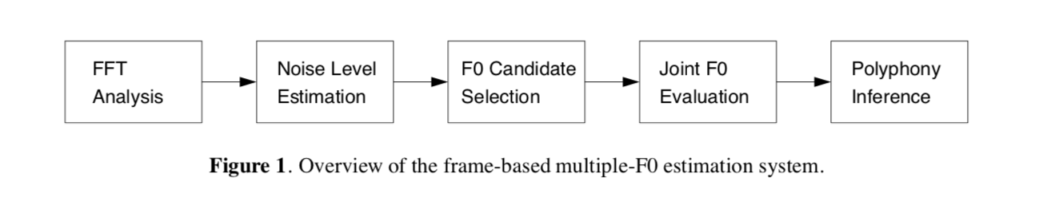
Multible-F0 Estimation for MIREX
Chunghsin YEH & Axel Roebel 2010
Going back to 2007 when this algorithm was first implemented:
Stage 1: Noise Level Estimation
- Subtracting spectral components classified as sinusoids
Stage 2: F0 Candidate Extraction
- This tries to minimize the possible F0 to improve the next stages efficiency. It uses a simple iterative estimation/subtraction process with harmonic F0 extraction.
Stage 3: Joint Evaluation of F0 Hypotheses
Uses 4 criteria. A linear combination of the four forms a score function which evaluates the plausibility of each combination of F0 hypotheses
Harmonicity
Mean bandwidth
Centroid of Hypothetical Partial Sequences
Standard deviation of mean time of the hypothetical partials.
Stage 4: Estimation of the Number of F0s
- F0 ranking candidates via their probabilities, sounds very Markov in nature. Build up a harmonic structure of the frame and and take the most plausible one

Slide 11
Frequency Domain Convolutions For F0 Estimation
John Thickstun, Zaid Harchaoui, Dean Foster, Sham Kakade 2017
This model is a convolutional neural network trained using MusicNet labels
This process uses a learned network with a filter bank of 512 windowed sinusoidal filters between 50Hz and 6KHz. A hand-crafted filter bank output helps with the convolutional architecture
The learned network has two layers.
Models convolves along the frequency axis of the input volume
Connects across the time axis
Then it is fed to a linear classifier for each pitch.
To avoid overfitting (to complex of a representation), speeding up and slowing down the audio is used along with jitter in pitch.

Slide 12


2012 – Present as a plugin
Emmanouil Benetos with:
2012 - Simon Dixon
2013-15 - Tillman Weyde
2016-2018 - Chris Cannam
Precision 75% - 80%
Recall 45% - 75%
Accuracy 66%
In 2016 the algorithm was put into a Vamp plugin and called:
Silvet – Shift-Invariant Latent Variable Transcription
It was originally created in 2012

Slide 13
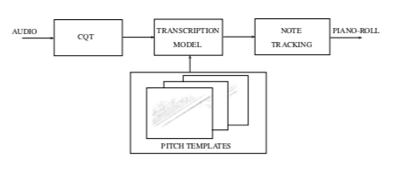
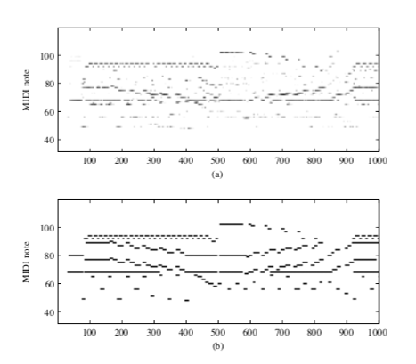
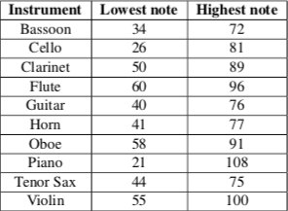
Shift-Invariant Latent Variable Transcription
Emmanouil Benetos & Tillman Weyde
Pitch Templates:
Are spectral templates of individual instrument notes through the whole range. 3 different piano and orchestral instruments were extracted from RWC samples using constant-Q transform (CQT) with a spectral resolution of 60 bins per octave and Probabilistic Latent Component Analysis (PLCA). Then the pitch range of each instrument is used from the following:
Transcription Model:
The audio input as CQT spectrum is used as a probability distribution with the multiple pitched instrument templates in a complex framework.
To make the algorithm create the most meaningful solutions, sparsity is encouraged in the transcription matrix. Only a few notes are expected at any given frame and only a few instruments can create these notes given the information from the templates. This information comes from the training stage which generates instrument templates that are used.

